Slide 1
Goal: Demonstrate two devices

Slide 2
Read data from the file
Filter (identify category)
fan
Laptop
STB
TV
Amplitude ratio
X=multi_devices/ one device

Slide 3
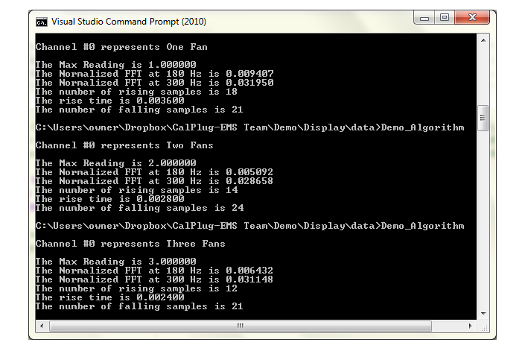

Slide 4
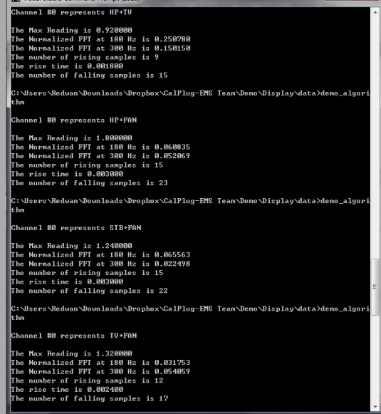
Demonstrate combined devices
Define fan+TV as a single device

Slide 5
New short term goal
Use different signatures to identify two different devices separately

